Slide 1


Slide 2
Contents
Introduction
Functional description
  Ontimize
  Ontimize More
  Ontimize ME
Technical description
Ontimize Plugin

Slide 3
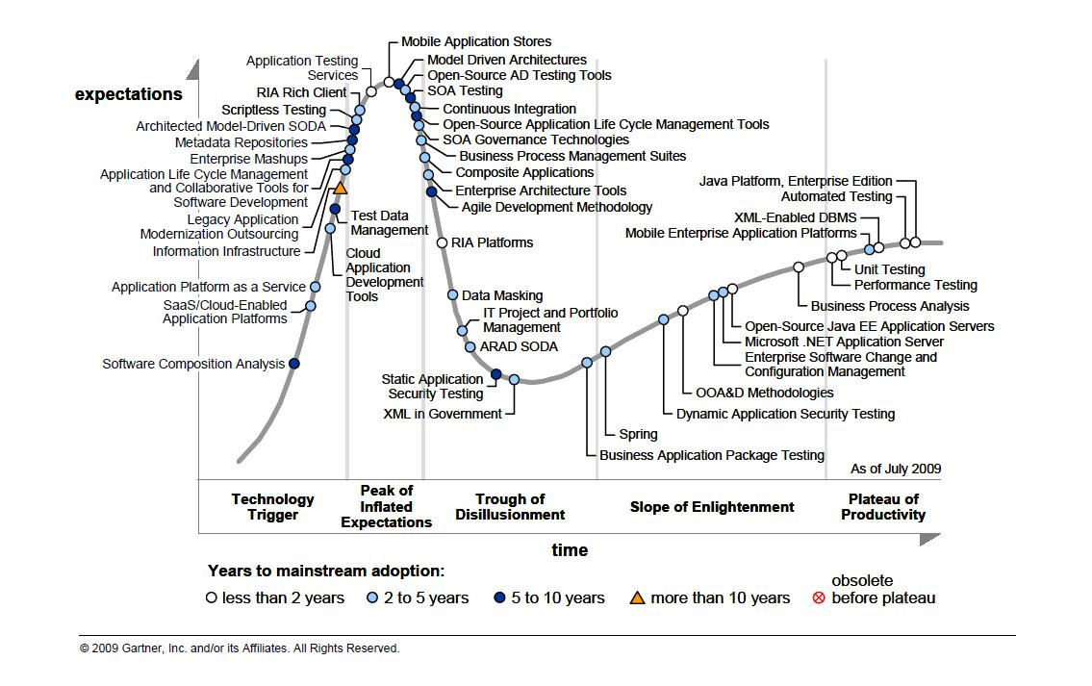
Hype Cycle for Application Development, 2009

Slide 4
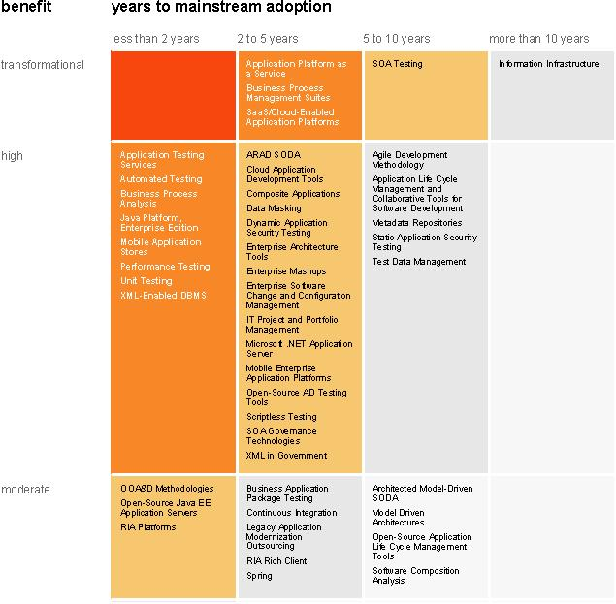
Technology Priority Matrix

Slide 5
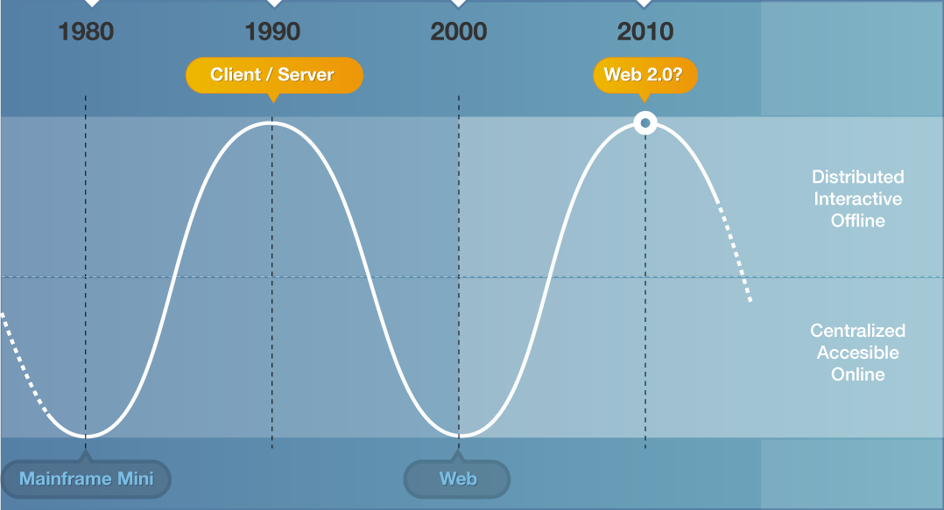
Software cycles

Slide 6
Software cycles
IT “reinvents” itself every 10 years
  Distributed vs Centralized
  Interactive vs Accessible
  SME vs Software Factory
  Rapid Development vs “hand coding”
  Personalized vs Standard

Slide 7
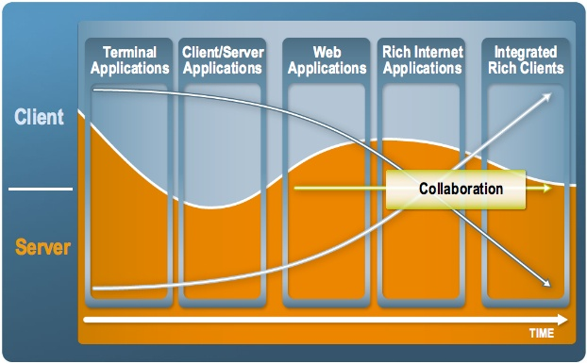
Next Wave according to SUN (JavaOne 2007)
Integrated Rich Clients
  Rich user experience
  Dynamic content
  Desktop application
  Not bound to a browser
  Full integration with web
  Full integration with host
  Ability to continue when disconnected
  Java Swing + Java FX
  Webstart Deployment
Other main players too
Microsoft: Silverlight
Adobe: Flex + AIR
Google: Gears

Slide 8
Software complexity
It’s very difficult to keep up to date
Commercial or “open-source”, there are just too many technologies to evaluate
General purpose languages (Java, C++, C#) do not offer enough productivity
Programmers are forced to use a combination of languages, libraries and products that do not integrate very well
The learning curve grows
The quality of software decreases

Slide 9
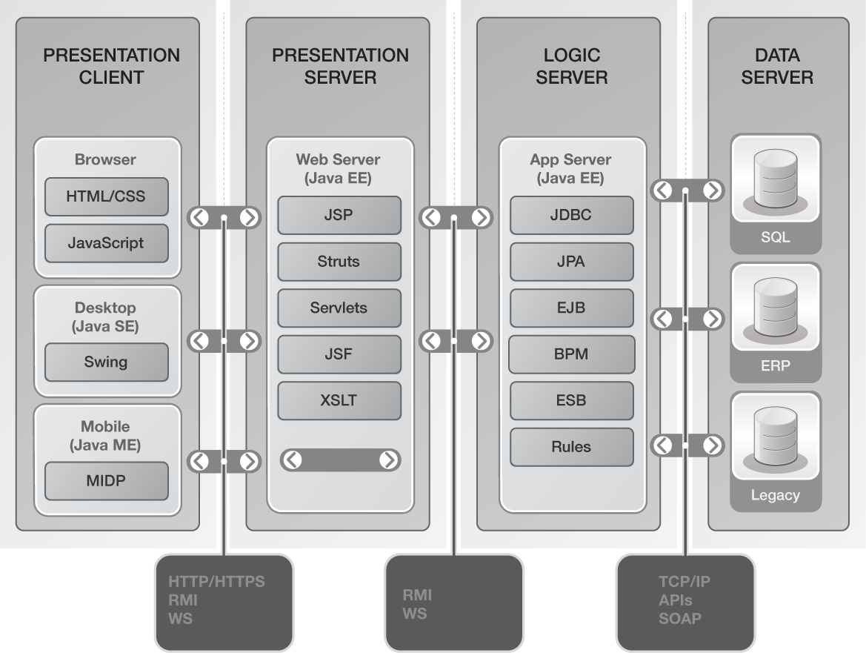
Software complexity - example

Slide 10
Development productivity
Hand coding using general purpose languages is not productive and error prone
IDEs are helpful but still require a lot of coding
Frameworks provide a reusable design that increases productivity for a specific domain
“Standard” frameworks (JSF, EJB, Spring,…) and APIs address general issues. These can be combined and built upon to create a
higher level “corporate” framework

Slide 11



What is Ontimize?
A declarative framework for developing interactive enterprise applications
Based on standards (Java and XML)
Multiplatform Interactive GUI
Goal: Simplify the use of technology
Result: Develop about 10 times faster
Desktop
Mobile
Browser*
* Under development

Slide 12
Advantages for your company
No need to develop your own Framework
Increased development productivity
Corporate IT strategy is implicitly introduced
Improved software quality
Simplifies the use of complex technologies
Tested
Evolves (new features available on future and existing applications)
Optimize your resources

Slide 13
Why Ontimize and not others?
Rich user interface
Internet technology
Covers many needs of enterprise applications
Based on well-known, standard technologies
Designed for software engineers (i.e. Eclipse)
Application definitions are stored in reusable programming language independent XML
Open architecture and access to source code
Flexible and attractive exploitation model

Slide 14
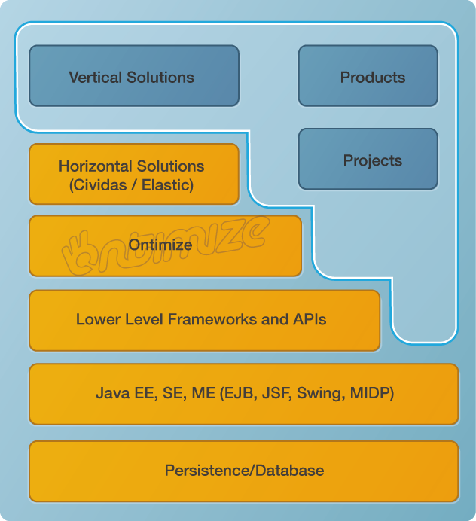
The role of Ontimize
Applications
Integrated and tested functional modules
Enterprise application development Framework
JFreeReport, JFreeChart, iText, JEP…
Weblogic, Websphere, iAS, JBoss, Glassfish
Oracle, SQL Server, PostgreSQL, MySQL
Notes:
Hacer que destaque ontimize en la gráfica

Slide 15
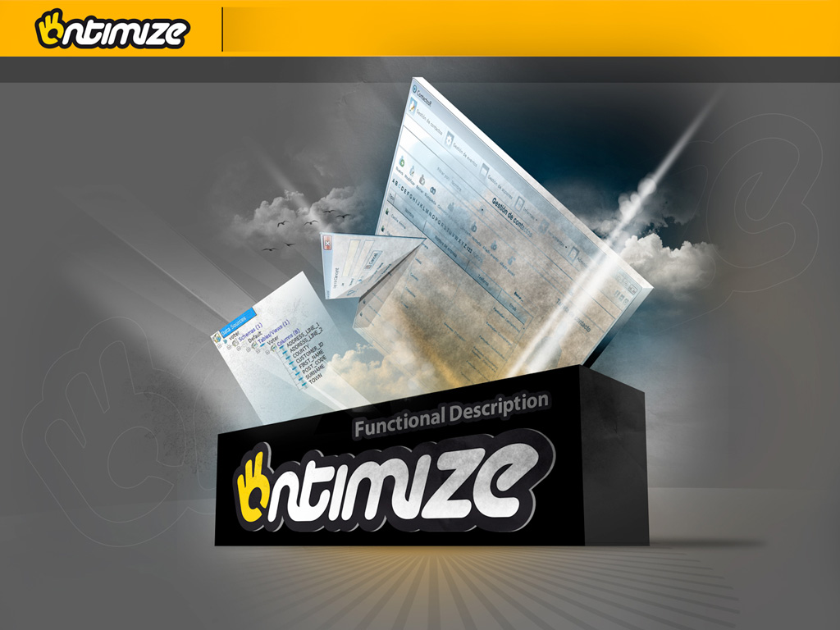
Functional Description

Slide 16
Functional Description
  Ontimize
  Ontimize More
  Ontimize ME
Notes:
Cajitas en chiquitito de las 3 functional descriptions

Slide 17
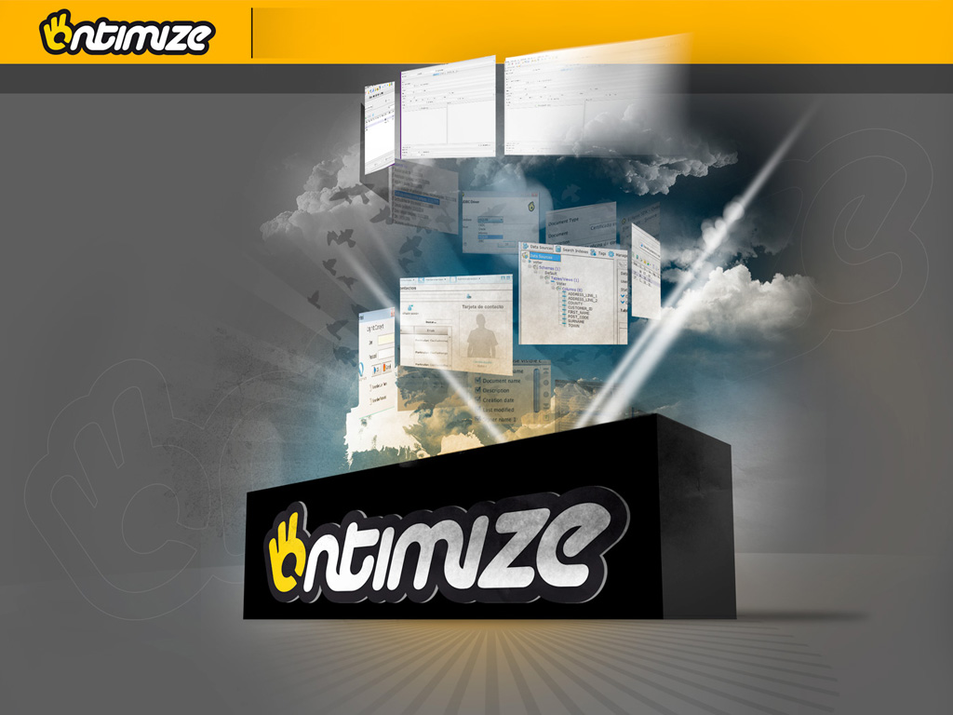
Ontimize

Slide 18
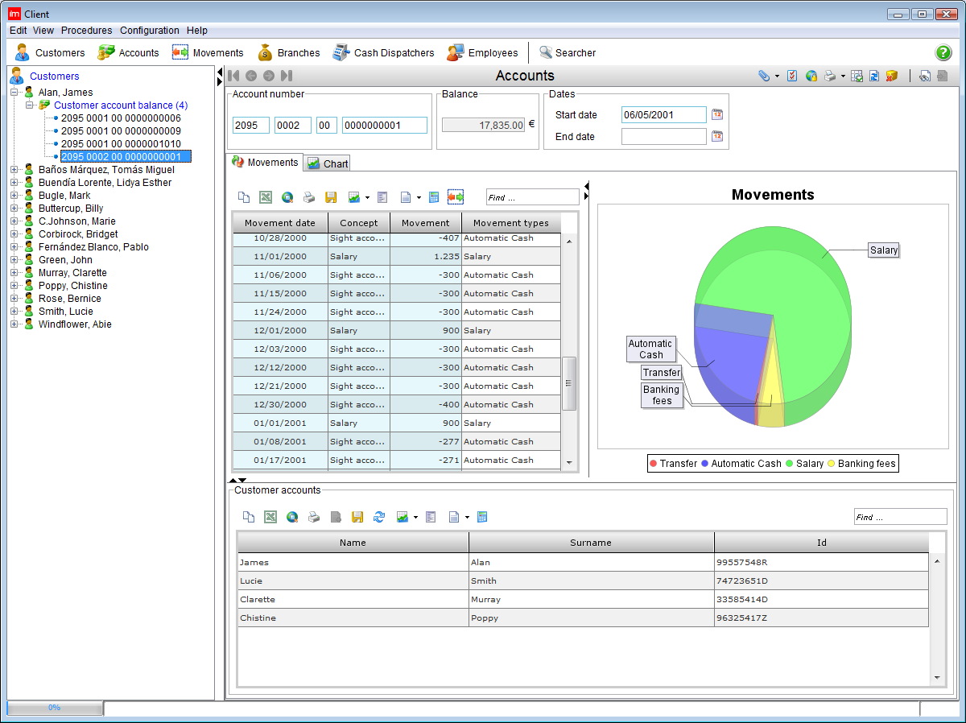
Application Structure
General Structure
  Window menu
  Screen menu
  Button bar
  Forms
  Trees
  Status Bar
General features
  Look & Feel preferences
  Language selection
  User customization
  Shortcuts configuration

Slide 19
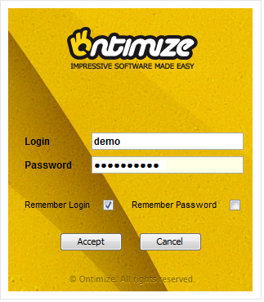
Access Control
Login
  User / Password
  Smartcard (i.e. Digital ID Card)

Slide 20
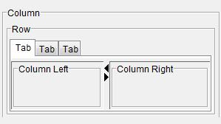
Forms: Containers
Containers are elements used to structure the Form
Ontimize uses a Dynamic Layout Strategy, automatically adjusting the position and the size of all the elements
You can add your own containers seamlessly
Containers
  Row
  Column
  TabPanel
  SplitPanel
  CardPanel
  More than 10 different containers to create any imaginable layout…

Slide 21
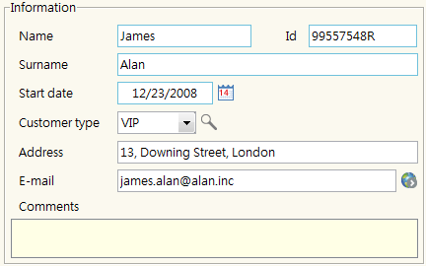
Forms: Fields
  Text: Normal, HTML, spell-checker
  Date: Calendar
  ID codes
  Number, calculated, money
  Web, e-mail, hyperlink
  Selection: combo (drill-down), code/description, list
  Image, charts
  More than 40 different fields to handle any data type
Fields are the elements that show information to the user

Slide 22

Forms: Fields: Image
Supports common image formats
Allows capturing from TWAIN compatible devices
Photo tools: magic wand, contrast, focus, …
Store in database or file system

Slide 23
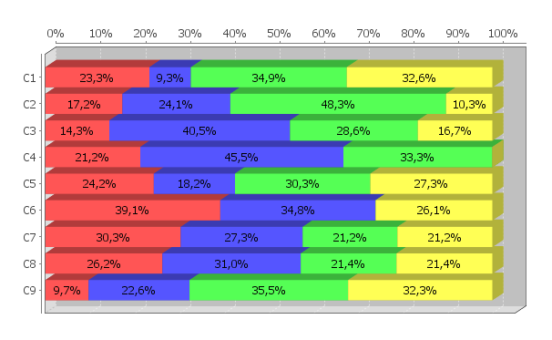
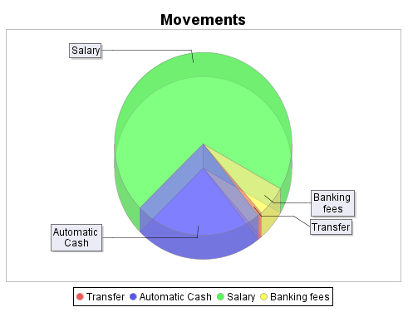
Forms: Fields: Charting
Shown in form or separate window
Line, Bar, Pie and 3D graphs
Multiple series and time series graphs
Print, export, zoom, etc.

Slide 24
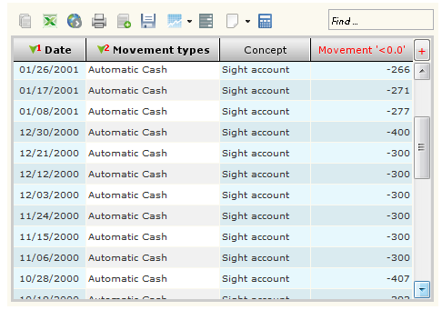
Forms: Tables 1/2
Display the information in a table
Lots of default features:
  Copy & paste to Excel, Clipboard
  Export to Excel, HTML
  Printing from the table
  Charting from the table
  Reporting from the table
  Multiple column sorting and filtering
    Quick filter
    Advanced Filtering
    Filtering, sorting and other operations executed in memory to improve performance

Slide 25
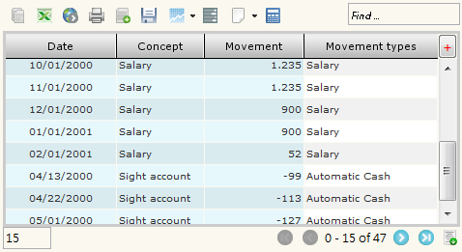
Forms: Tables 2/2
  Column grouping with aggregate functions:
    Sum, average, maximum, minimum
  Column visibility, position and width configuration
  Store and recover filtering, sorting, grouping and configuration options, in the server
  Pivoting feature in OLAP style
  Inserting data straight from the table
  Pageable table

Slide 26
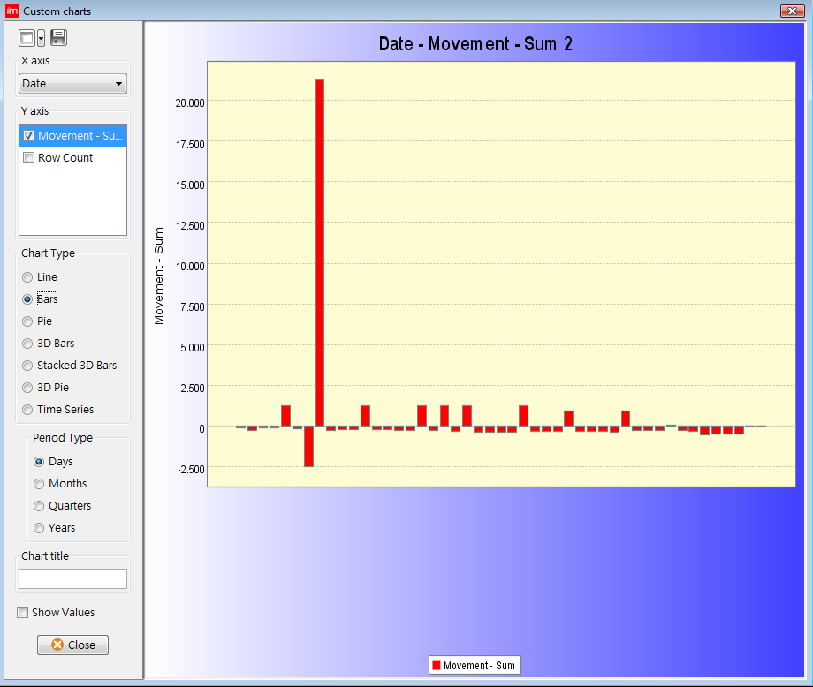

Forms: Tables: User defined charts
Using the data from any table
The user selects x, y and graph type
Temporal series grouping (day, week, month, quarter, year)
Save and recover graph definition

Slide 27
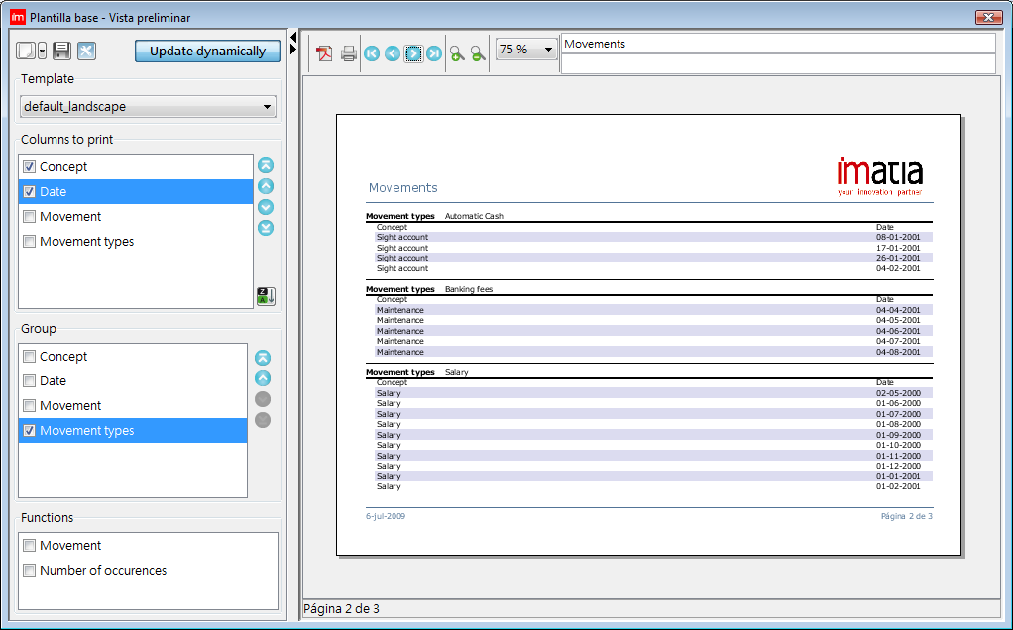
Forms: Tables: User defined reports
Using the data from any table
User chooses columns, groupings, totals, etc.
User and corporate template repository
Print, export, zoom, etc.
Support for JFree and Jasper report templates

Slide 28
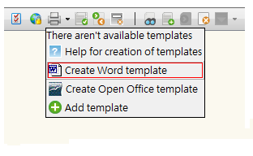
Forms: Templates
Fill in a document with the data from any form
User and corporate template document store
Users can create, update and modify their own templates
Supports
  Microsoft Word
  PDF
  Open Office

Slide 29
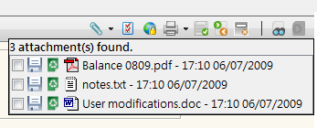
Forms: Attachments
Attach files to any register on any form
Private/Public
Comments on one or a set of files
Background upload and download
Open file with associated program

Slide 30
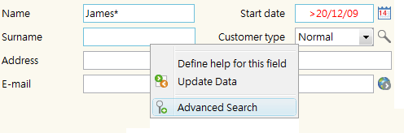

Forms: Basic interaction
Search
  Multiple conditions
  Approximate searches
  Operators
    <, >, <=, >=, <>
  Dates, Numbers, Text
  Allows configuring the attributes that will appear on a summary table
Queries stored in the server
Insert
Update
Delete

Slide 31
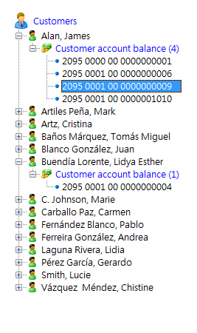
Trees
Allows exploring a hierarchic data structure
When a node is selected, details are shown in a form
Only requires defining the desired hierarchy
User configurable sorting

Slide 32
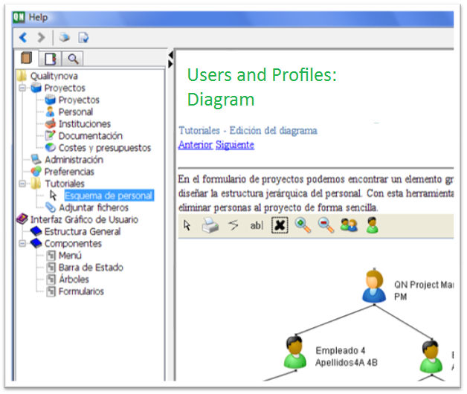
Online Help
Contents
Search
Context sensible help
Direct access from forms to sections
Web style navigation, through links
User defined help in the Fields

Slide 33
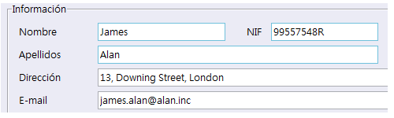
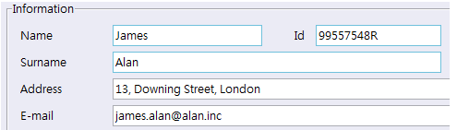
Internationalization
Language (locale) selection
Labels and messages
Adaptive layout
Date, number and money formats
Easy translation
Dynamic
Stored in the database
User configurable translations
Notes:
Bundle in the database

Slide 34
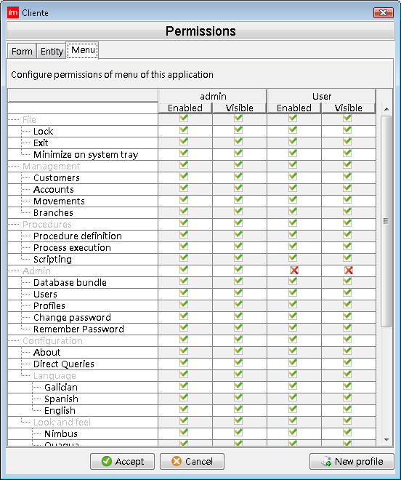
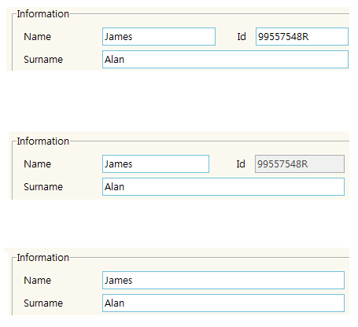
User permissions and roles
GUI
  Menus, trees, forms and fields that a user can access or write
Server
  Set of data that a user can access (entities, attributes and registers)
  Temporal restrictions
  Restrictions on operations
Graphical configuration
Notes:
Add the permissions component

Slide 35


Slide 36
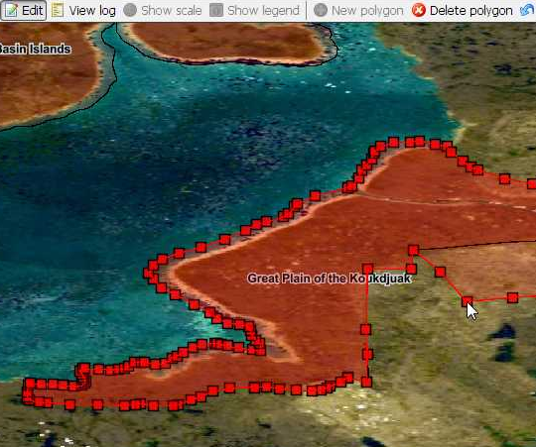
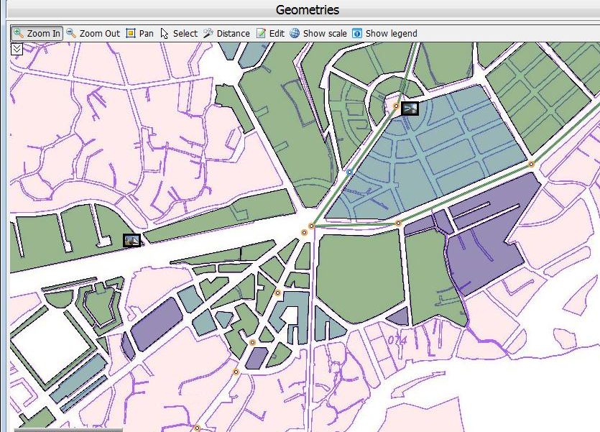
Map Viewer (GIS): Data
Data types
  Raster
    Georeferenced images
    Maps
  Vector
    Shapefiles (ESRI)
    DXF (Autocad)
Geographic data
  Points, lines, multiple lines, polygons
Alphanumeric data
  Ontimize

Slide 37
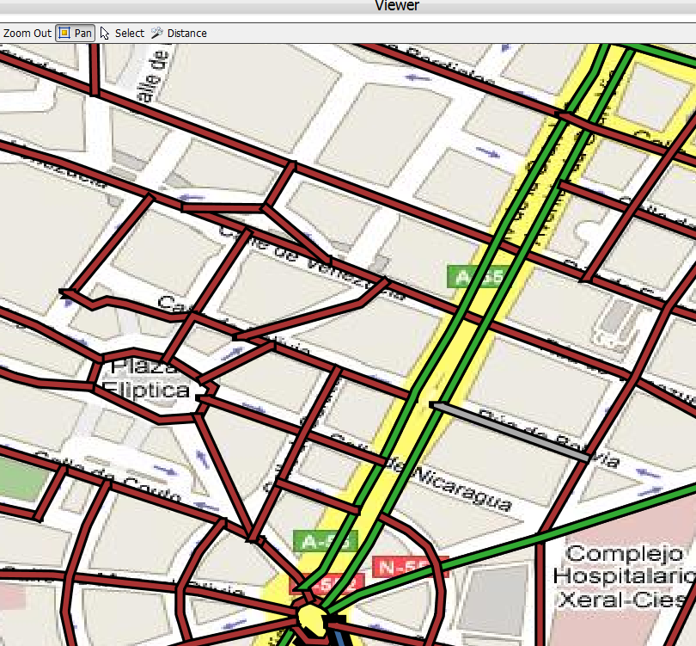
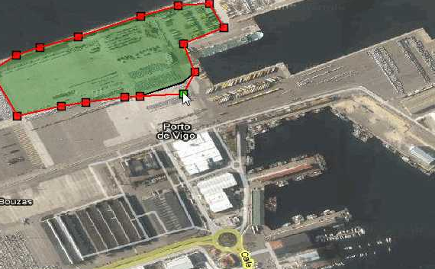
Map Viewer (GIS): Features
Most common providers integration
  Google Maps
  OpenStreet Maps
  WMS servers
User tools
  Graphical search
  Symbol, line and color configuration
  Graphical data modification
Geographical tools
  Several projections allowed

Slide 38
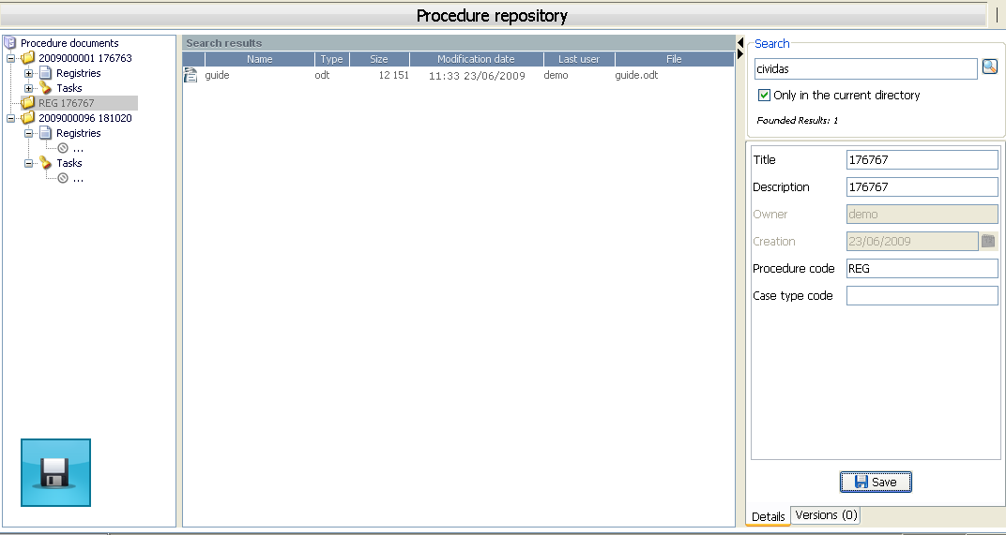
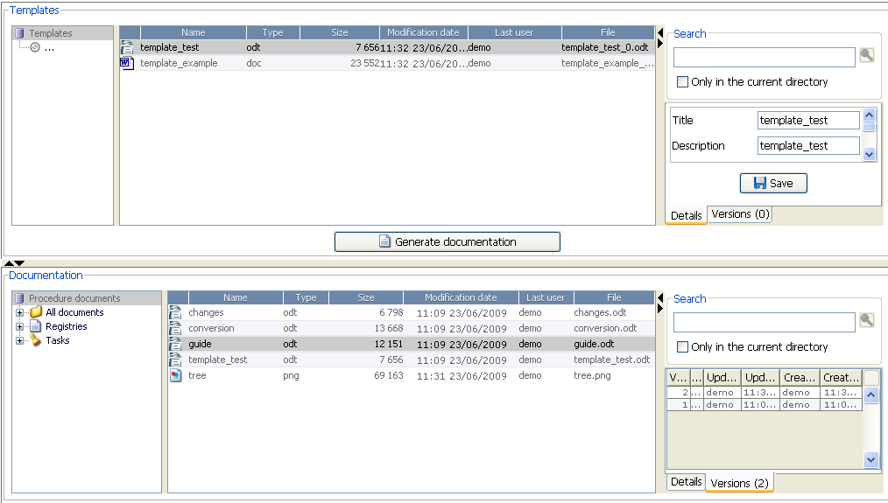
Document Management
JCR Integration (Java Content Repository)
Access control
Document properties
Content & properties based searches
Cache of structure and documents that have been requested or may be needed
Automatic modification detection
Transparent upload & download
Offline support
Drag & Drop
File traceability

Slide 39
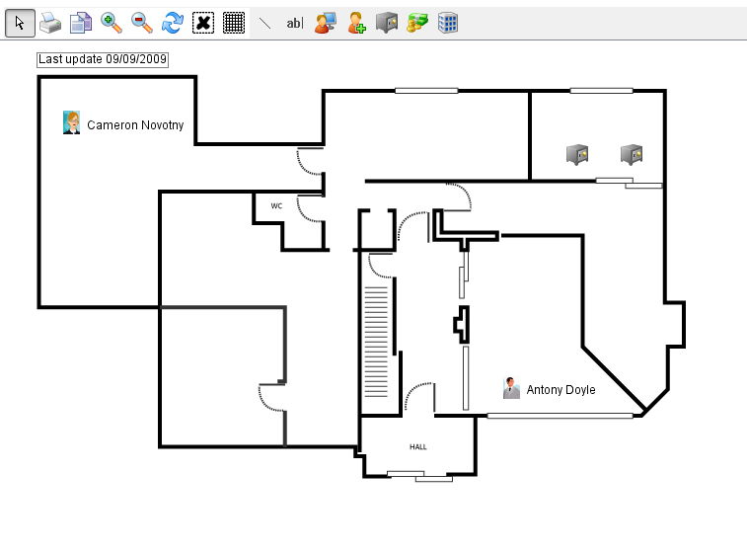
Diagram Editor
Configurable drawing elements
  Org-charts
  Processes
  Schematics
Access to related forms
Quick-view of associated data
Graphical collaboration over the Internet

Slide 40

Control and Monitoring (SCADA)
Internet access
Configurable diagrams
Installation types
Alarm management
Simulation & playback
Monitoring & control via GPRS, UMTS, SMS, TCP/IP
MODBUS interface
E-mail or SMS notifications
Data & reports
Graphs

Slide 41
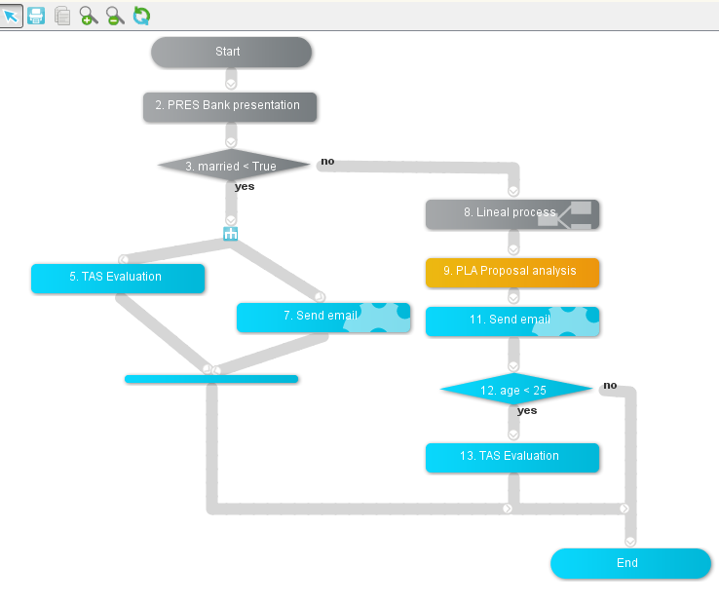
Workflow
Workflow Engine
  Tasks
  Decisions
  Timers
  Concurrency
  Synchronization
  Triggers
  Messages
Visual Editor
  Integrated in Ontimize
  Contextual
Users can:
  See flow diagram / state
  Launch tasks from diagram or list

Slide 42
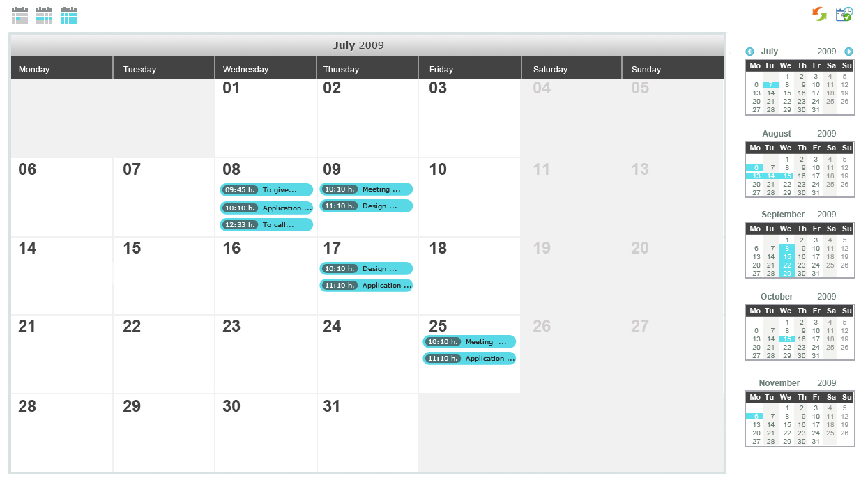
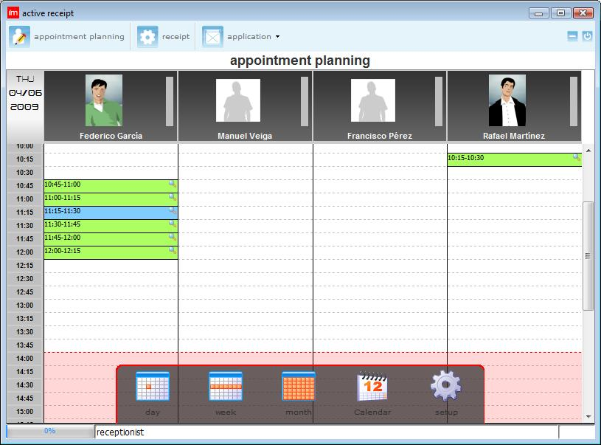
Agenda / Planning
View events for multiple resources
Events linked to entities and forms
Different types of events and activities
Include event information in reports
Multi – user tasks management
Notes:
See R Contacts

Slide 43
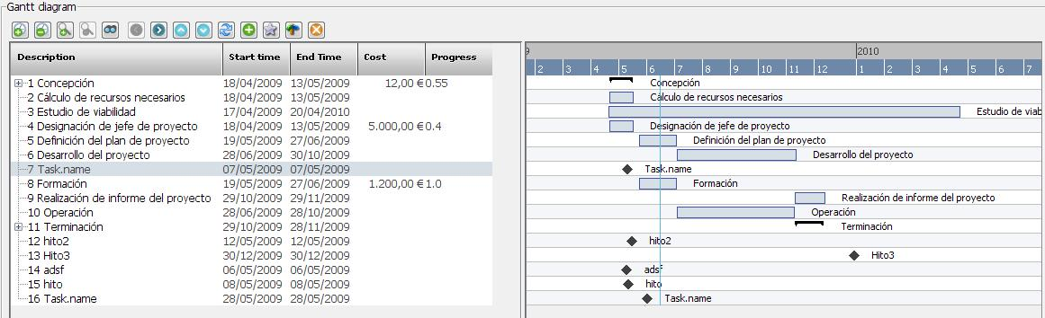
Gantt
Work packages
Dependencies
Linked to entities and forms
Visual editing
Notes:
See R Contacts

Slide 44
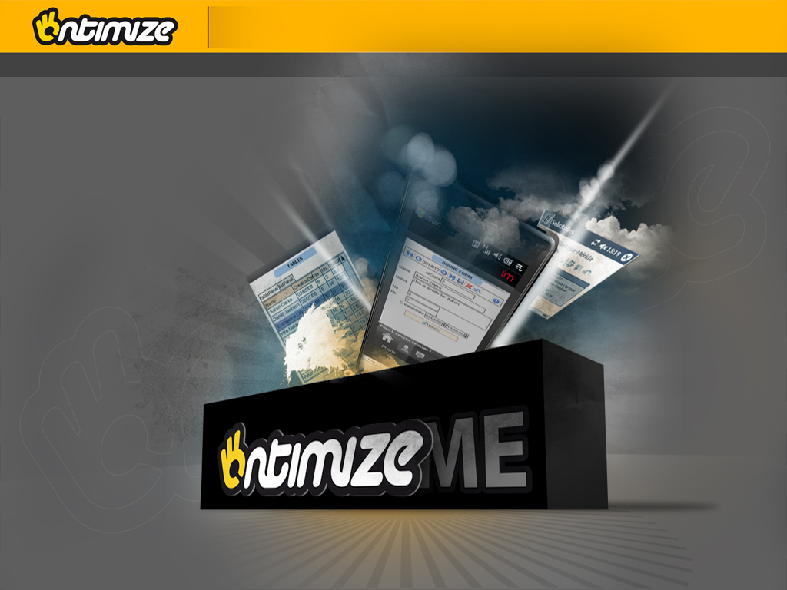

Slide 45
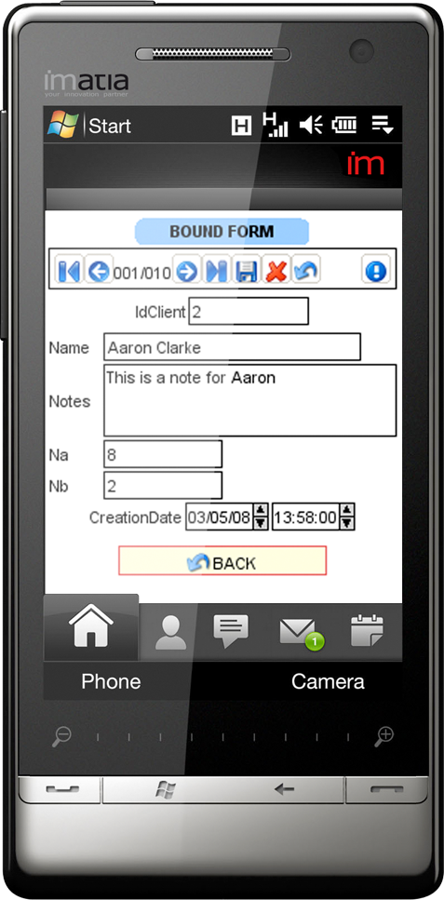
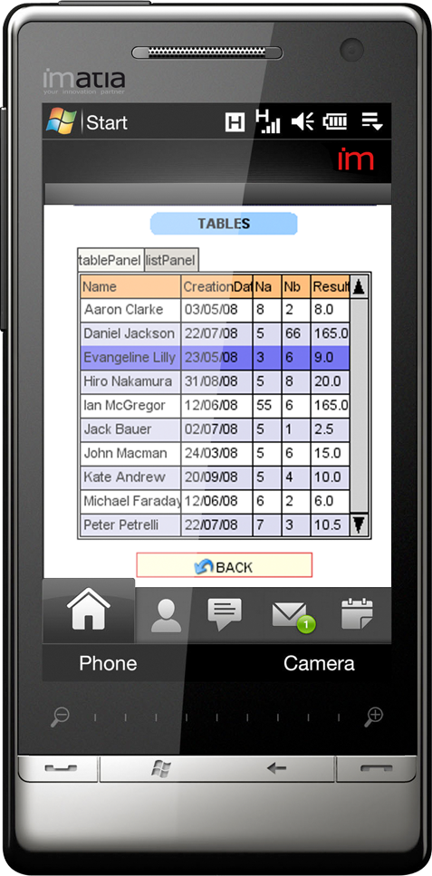
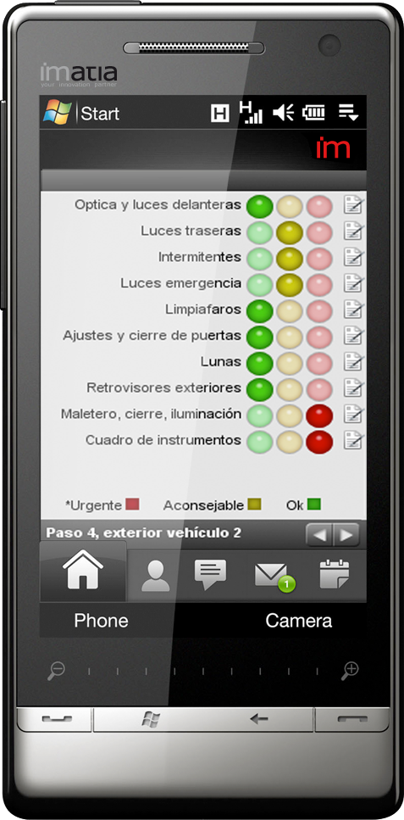
Ontimize ME
Ontimize for Mobility Solutions
Focused on the GUI and the connectivity
Online / offline support
  Standalone applications
100% compliant to Ontimize
Open and scalable
  Based on XML and Java ME
  Allows inserting custom components

Slide 46
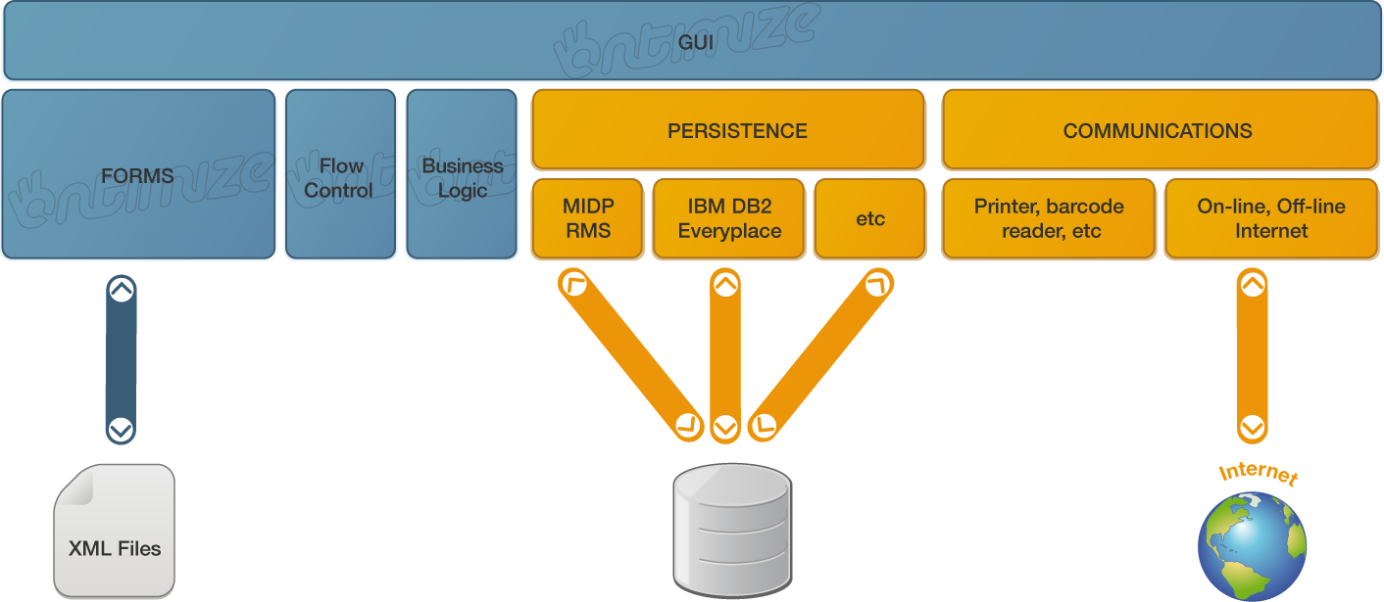
Ontimize ME: Architecture
Easy deployment and update
  Over-the-air (OTA)
  CAB files
  MSI (ActiveSync)
  PRC (Palm)
Ontimize synchronization
Stand alone persistence
Ontimize communication

Slide 47
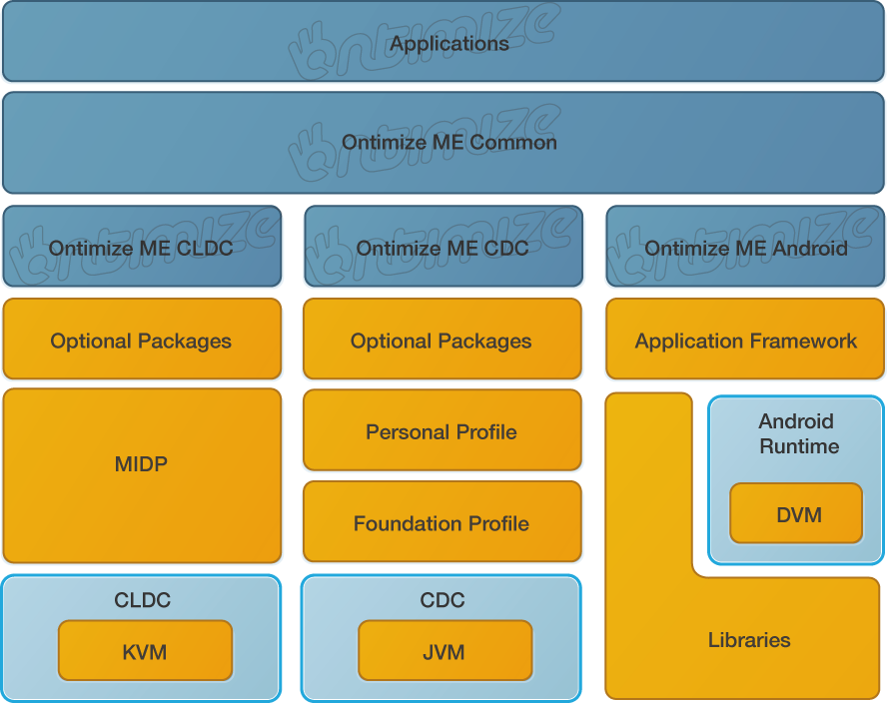
Ontimize ME: Stack

Slide 48


Slide 49
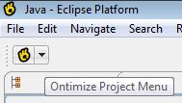
Ontimize Eclipse Plugin
Eclipse plugin to automate and speed up Ontimize Application development
  Increases productivity & efficiently
  Reduces the number of errors
  Visual development and edition
  Handles the databinding automatically
Automates the XML and configuration files generation
Contains documentation, videos and other information useful for the developer
Notes:
See R Contacts

Slide 50
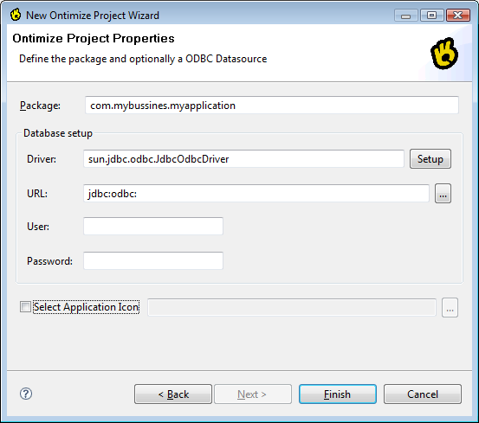
Ontimize Eclipse Plugin
Wizards to perform the most usual tasks
  Data providers mapping
  Application screens design
  Application deployment
Ontimize SDK
  A complete eclipse with the Ontimize plugin ready to use
Notes:
See R Contacts

Slide 51
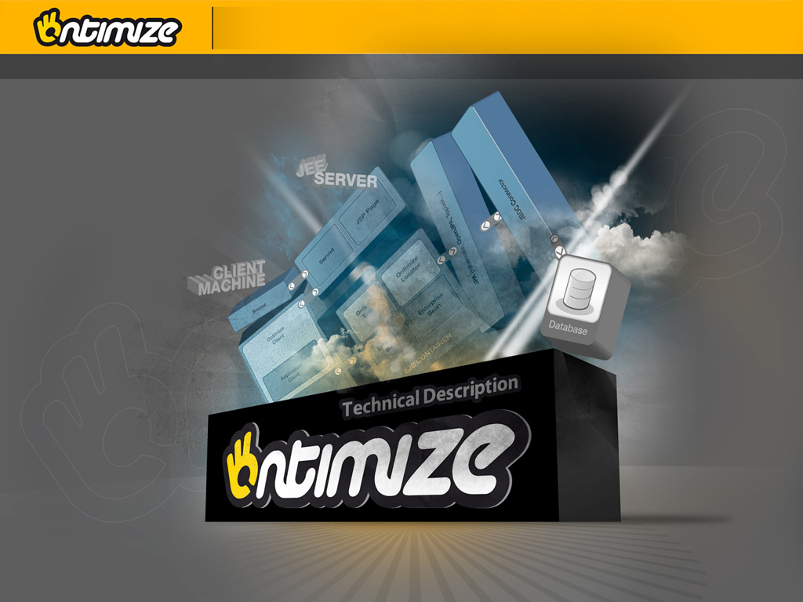

Slide 52
Declarative approach
Ontimize allows you to define what application you wish to have:
  Client (Graphical User Interface)
  Server (Data Entities)
Without having to worry about how to implement it in a program
Basic logic (presentation and business) is included
Advanced logic is programmed
This allows implementing many user requirements without programming
Rapid Prototyping
Notes:
See R Contacts

Slide 53
XML as a declarative language
In Ontimize declarations are expressed in XML
This has many advantages:
  Widely used standard
  Programming language independent
  Hierarchical
  Extensible (tags)
  Many tools available (editors, verifiers, etc)
  Can be transformed (XSLT), making the effort reusable
Notes:
See R Contacts

Slide 54
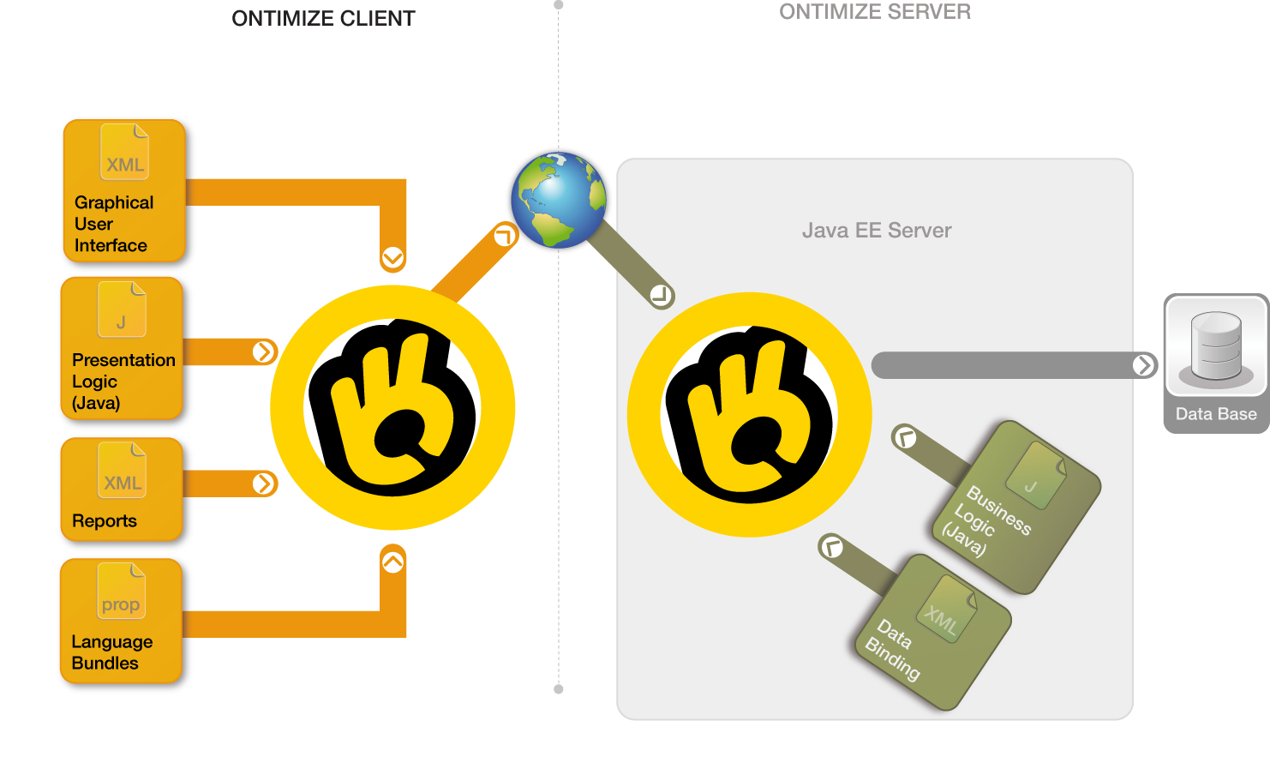
General Architecture
Notes:
See R Contacts

Slide 55
Ontimize Client 1/3
Reads an XML file that describes general parameters and references files that describe:
  Menu and button bar
  Trees
  Forms
  Presentation logic classes (event listeners)
  Report formats (JFreeReport)
  Language labels (bundles)
XML tags are mapped to Ontimize classes or custom classes
Notes:
See R Contacts

Slide 56
Ontimize Client 2/3
Using these files, the Ontimize Client:
  Creates supporting data structures
  Instantiates classes when needed (late binding)
  Manages form loading, state and cache
  Manages dynamic component layout
  Provides basic presentation logic
  Manages custom presentation logic classes
  Manages communications with the server
  Manages user authentication
  Implements presentation security policies
Notes:
See R Contacts

Slide 57
Ontimize Client 3/3
Basic Presentation Logic:
  Login
  Invoke forms from the menu or button bar
  Trees: populate, invoke form, update inserts,..
  Forms:
    Field format validation
    Data manipulation (CRUD: create, read, update and delete)
    Master-detail: multiple, deferred insert,…
    Cache: forms, data, …
  Tables (grids): populate, refresh, filter,…
  Drill-down from tables and components
  User preferences, internationalization, …
  Interaction with local devices
  Reports, graphs, attachments, documents,…
Notes:
See R Contacts

Slide 58
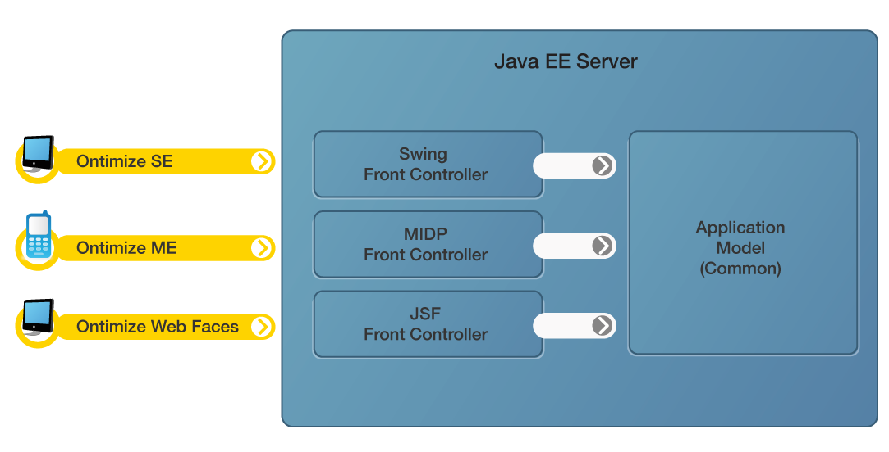
Ontimize Server Architecture 1/2
Notes:
See R Contacts

Slide 59
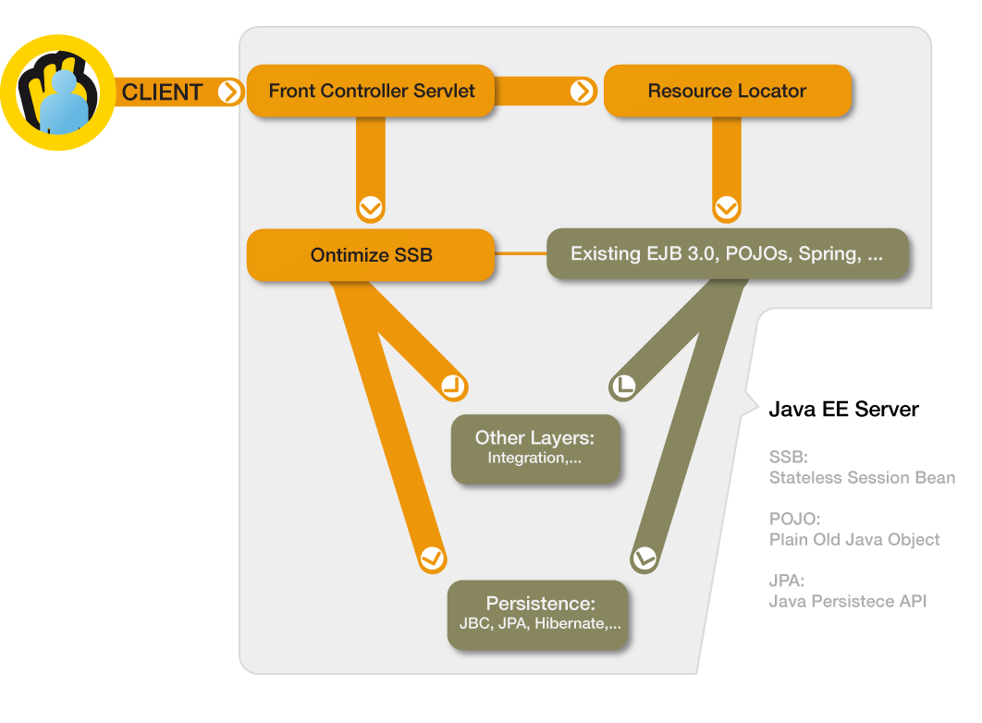
Ontimize Server Architecture 2/2
Presentation
Business
Logic
Notes:
See R Contacts

Slide 60
Ontimize Server 1/3
Acts mainly as a presentation server and provides some facilities for the business/persistence layers
Provides a “front controller” that receives client requests and dispatches them to EJB 3.0 Stateless Session Beans (SSB) or POJOs that implement business logic
SSB that provide the basic business logic required by the Ontimize Client and automatic binding to JPA entities or JDBC are included (optional)
Developers can extend these or create their own SSB to provide specific business logic
Notes:
See R Contacts

Slide 61
Ontimize Server 2/3
Security
  Support for single sign-on (LDAP, Kerberos,…)
  Container security defined using standard annotations
  Business logic security can be defined in XML: attributes, domains (rows), conditions, time constraints
Communications designed for the Internet
  Latency: remote calls are minimized, encapsulating data in a single object per request
  Bandwidth: dynamic data compression
  Encryption (SSL) & tunneling (HTTP or HTTPS)
Notes:
See R Contacts

Slide 62
Ontimize Server 3/3
Basic Business Logic:
  User authentication & session management
  Data Manipulation (CRUD)
  Collecting data from multiple related entities
  User access log
  Transparent access to local and remote databases
  Secure and efficient communications
  Image, file and report repositories
Notes:
See R Contacts

Slide 63
Open & Programmable
Using Java, a developer can:
  Include custom components
  Implement custom presentation logic
  Implement custom business logic
  Interact with devices and other systems
High level (Ontimize API) and low level (Swing, JDBC, etc.) programming supported
Notes:
See R Contacts

Slide 64


Contact
Vigo
Polígono Industrial A Granxa
Paralela 1 (calle D) - Casa de Piedra
36400 Porriño (Pontevedra)
España
Tel: +34 986 342 774
Fax: +34 986 342 298
---------------------------------------------------------------------------------------------------------------
E-mail: contact@imatia.com
www.ontimize.com
A Coruña
Edificio "Torre de Cristal“
Enrique Mariñas 36, Planta 8
15009 A Coruña
Tel: +34 881 242 970
---------------------------------------------------------------------------------------------------------------
E-mail: contact@imatia.com
www.ontimize.com

